Slide 1

Turing Feasibility Project
Close-Out Presentation for the Department for Education

Slide 2
Structure of the Presentation
Aim, Objectives, Deliverables and Current Estimating Performance
Data Suitability for Predictive Model Building
Predictive Model Building
Improving predictability

Slide 3
Aim and Objectives
AIM: To test the feasibility of using AI to improve the delivery of DfE school construction projects.
Specifically, this will involve the following objectives:
assessing the nature of the real-world project delivery data
building predictive models for project delivery using machine learning from that data
Deliverables
Final Presentation (.pptx)
Cleaned datasets with data glossary (.csv)
Python code workbook (.ipynb)

Slide 4
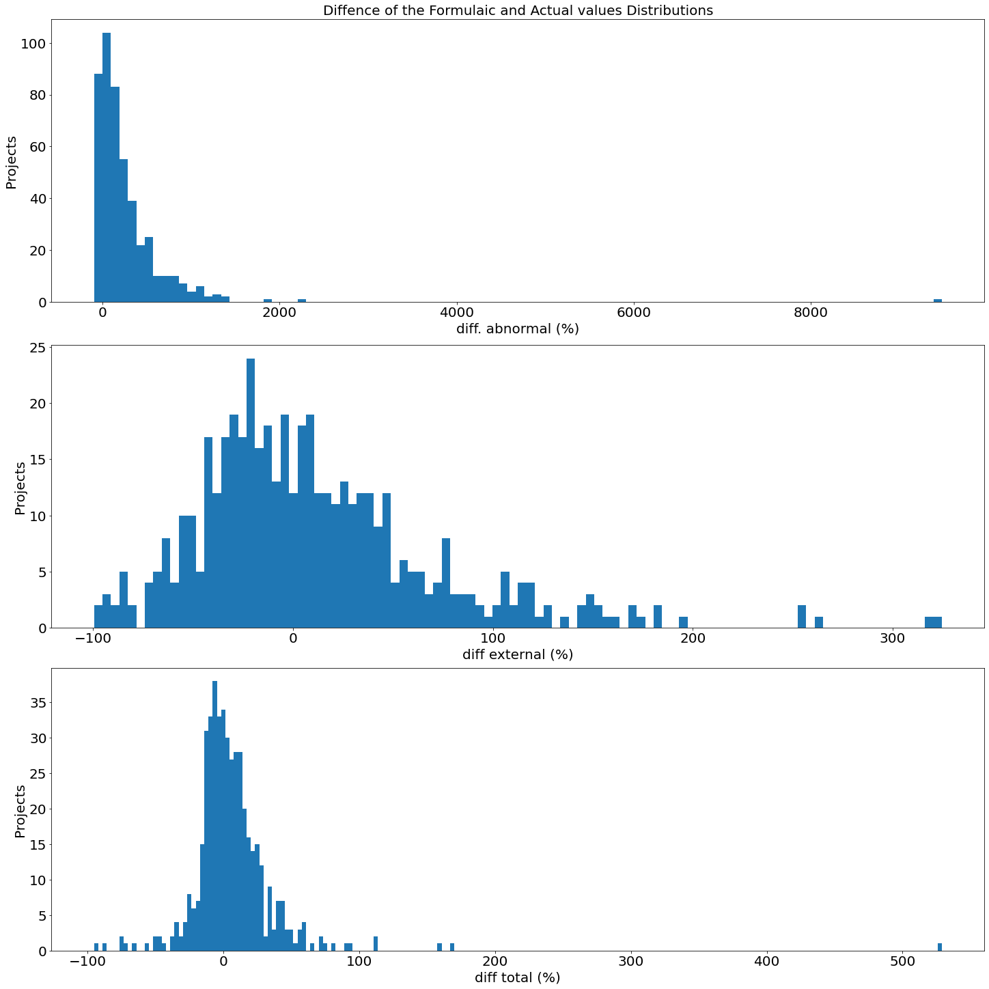
Current Estimating Performance
Diff Abnormal Cost
Diff External Cost
Diff Total Cost

Slide 5
Data Suitability

Slide 6
Dataset Suitability I: “Before” & “After” datasets
Dataset provided by DfE (.xlsx)
Number of Projects: 544 Number of Variables: 53
“Cleaned” Dataset used by WMG
Number of Projects: 423 Number of Variables: 33
 | Independent Variables | Notes
1 | Project categories | 5 Categorical Variables (transformed to 32 binary variables) 1 Numerical Variable (Size)
2 | Location | Region
3 | Contractor | Contractor ref
4 | On site or Off site | Traditional or modular
5 | Procurement framework | Framework
6 | Size | SIZE GIFA (m2)
 | Dependent Variables | Notes
1 | Diff External Cost | WMG Created Diff between actual and planned value
2 | Diff Abnormal Cost | Region
3 | Diff Total Cost | Contractor ref
4 | Actual External Cost
5 | Actual Abnormal Cost
6 | Actual Total Cost

Slide 7
Data Suitability II- The Data Pipeline
Dataset Collation
Exploratory Data Analysis
Data Cleansing
Data Pre-Processing
Selected 7 characteristics
and 6 independent variables
Removed 121 projects with
Missing performance variables
Checked the distribution
Of variables and found them
satisfactory
Eliminated ‘pupil number’
because of high correlation
with ‘size’
Created ‘diff variables to
Do this
Aggregated categories of 4
performance variables
Filled in missing values for Site Type, framework and size
Created a data glossary
for this dataset
Used hot-encoding to convert 5 categorical to 32 binary variables

Slide 8
Predictive Model Building

Slide 9
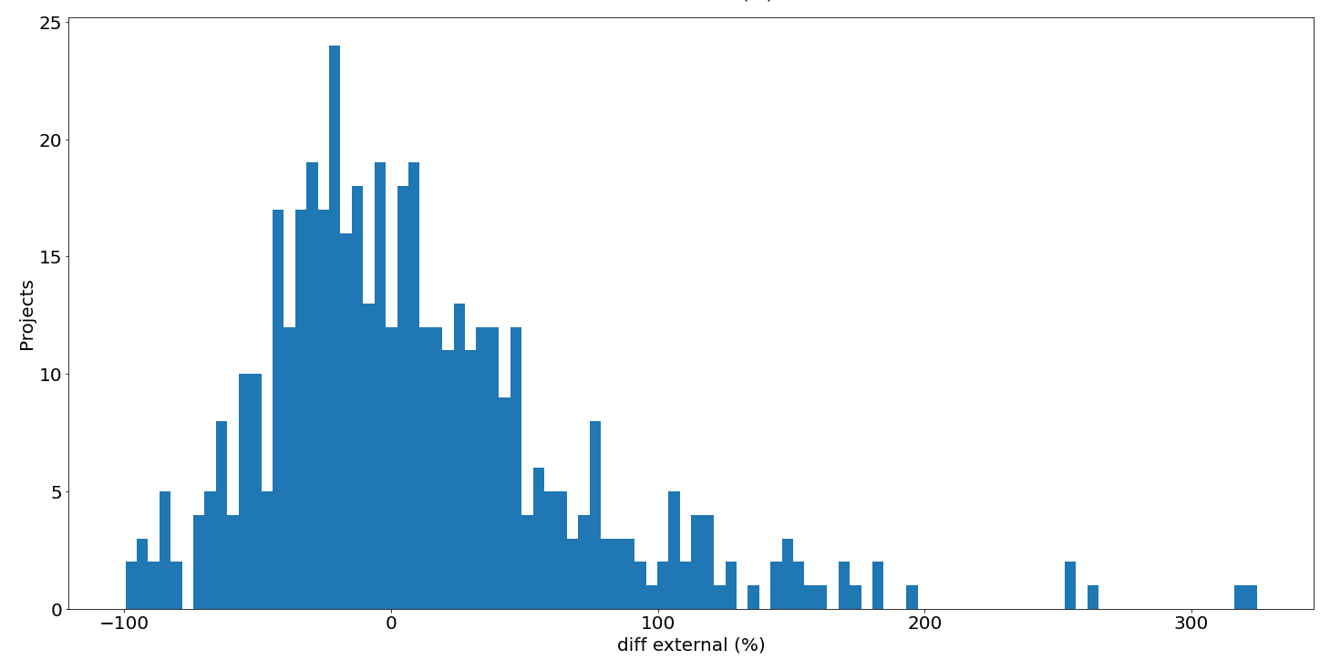
Turning the Diff Numerical to Categorical values
Under-estimate
Over-estimate
-10 %
10 %
Acceptable

Slide 10
Predictive Model Building I – Comparative Algorithm Performance
Project Performance (Dependant) Variables | Test-set Accuracy (%) of Algorithms (Categorical Classification)
 | Logistic Regression | Decision-Tree Classifier | KNN | Naïve Bayes | SVM | SGD Classifier | ANN
Diff. external cost | 49.5 | 49.5 | 44.2 | 44.2 | 51.6 | 56.8 | 54.7
Diff. abnormal cost | 68.4 | 67.4 | 60.0 | 41.1 | 74.7 | 70.5 | 63.2
Diff. Total | 48.4 | 55.9 | 58.9 | 30.5 | 63.2 | 47.4 | 44.2
3 perf. Categories
crested

Slide 11
Predictive Model Building I – Comparative Algorithm Performance
Classification Performance Metrics | Accuracy, Precision and Recall of Algorithms (Categorical Classification) Diff External
 | Logistic Regression | Decision-Tree Classifier | KNN | Naïve Bayes | SVM | SGD Classifier | ANN
Accuracy | 49.5 | 49.5 | 44.2 | 44.2 | 51.6 | 56.8 | 54.7
Precision | 0.238 | 0.22 | 0.167 | 0.231 | 0.250 | 0.357 | 0.180
Recall | 0.278 | 0.222 | 0.333 | 0.667 | 0.222 | 0.278 | 0.170

Slide 12
Predictive Model Building I – Comparative Algorithm Performance
Classification Performance Metrics | Accuracy, Precision and Recall of Algorithms (Categorical Classification) Diff Abnormal
 | Logistic Regression | Decision-Tree Classifier | KNN | Naïve Bayes | SVM | SGD Classifier | ANN
Accuracy | 68.4 | 67.4 | 60.0 | 41.1 | 74.7 | 70.5 | 63.2
Precision | 0.111 | 0.091 | 0.111 | 0.053 | 0.20 | 0.143 | 0.110
Recall | 0.333 | 0.333 | 0.333 | 0.333 | 0.333 | 0.333 | 0.333

Slide 13
Predictive Model Building I – Comparative Algorithm Performance
Classification Performance Metrics | Accuracy, Precision and Recall of Algorithms (Categorical Classification) Diff total
 | Logistic Regression | Decision-Tree Classifier | KNN | Naïve Bayes | SVM | SGD Classifier | ANN
Accuracy | 48.4 | 55.9 | 58.9 | 30.5 | 63.2 | 47.4 | 44.2
Precision | 0.513 | 0.710 | 0.649 | 0.00 | 0.675 | 0.647 | 0.510
Recall | 0.488 | 0.537 | 0.585 | 0.00 | 0.659 | 0.268 | 0.660

Slide 14
Predictive Model Building I – Comparative Algorithm Performance
Project Performance (Dependant) Variables | Test-set R-squared values of Algorithms (Continuous Classification)
 | Linear Regression | Decision-Tree Regressor | Gradient Boosting Regressor | Random Forest Regressor | SVM
Actual External Costs | 0.709 | 0.497 | 0.737 | 0.745 | 0.682
Actual Abnormal Costs | 0.505 | 0.359 | 0.520 | 0.599 | 0.530
Actual Total Costs | 0.863 | 0.839 | 0.881 | 0.880 | 0.886
Actual values used

Slide 15
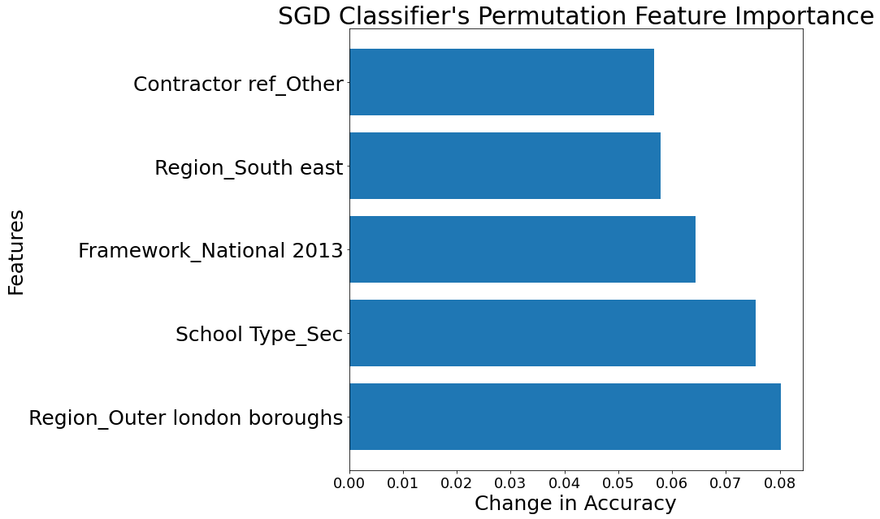
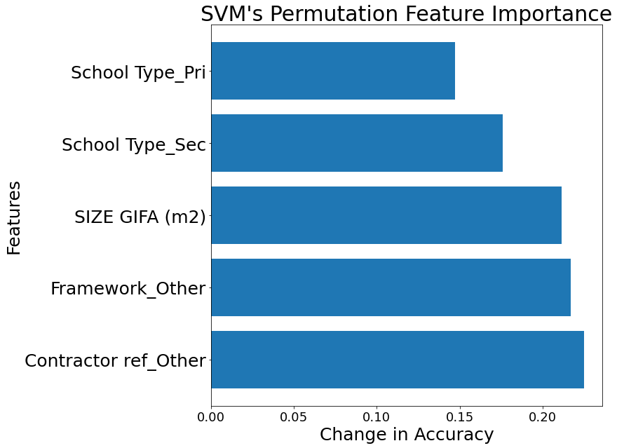
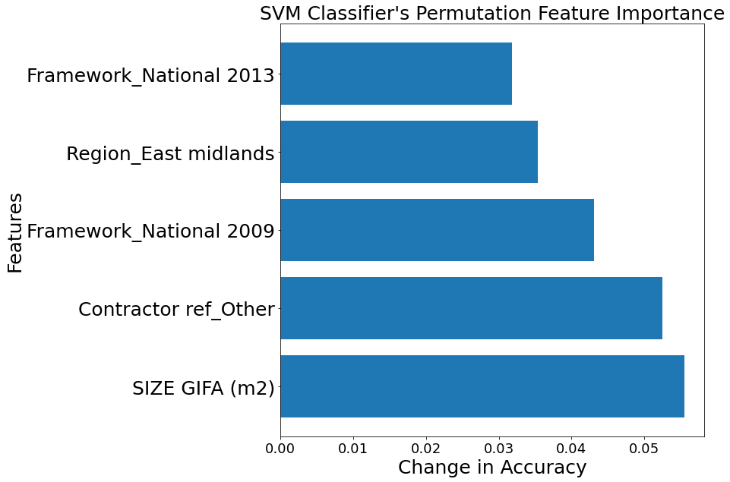
Predictive Model Building II- Predictive Characteristics
Diff External Costs
Diff Abnormal Costs
Diff Total Costs

Slide 16
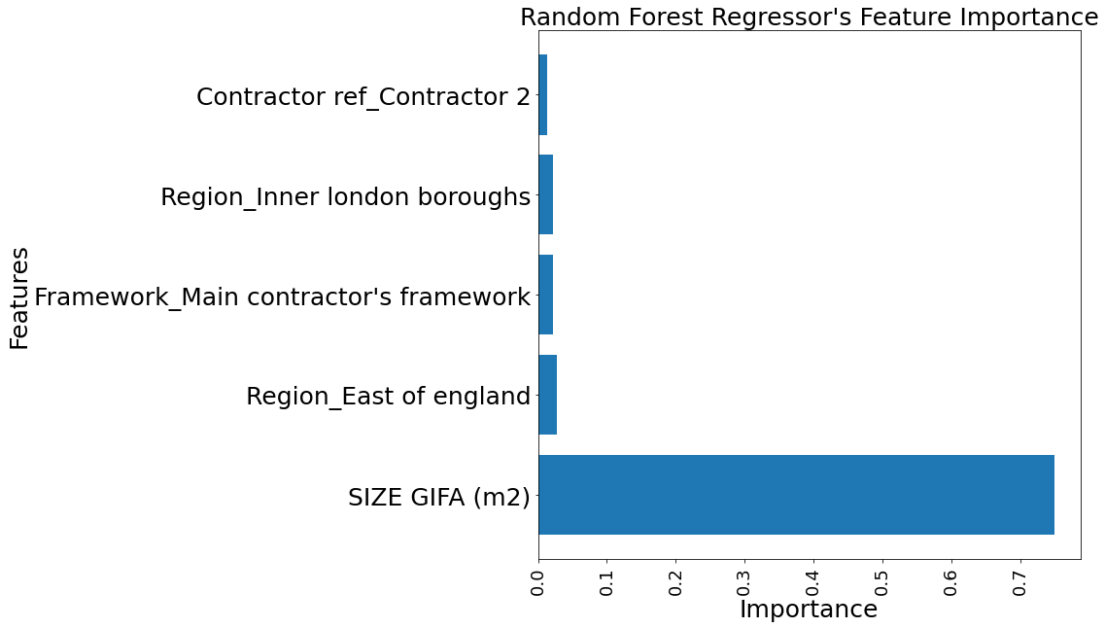
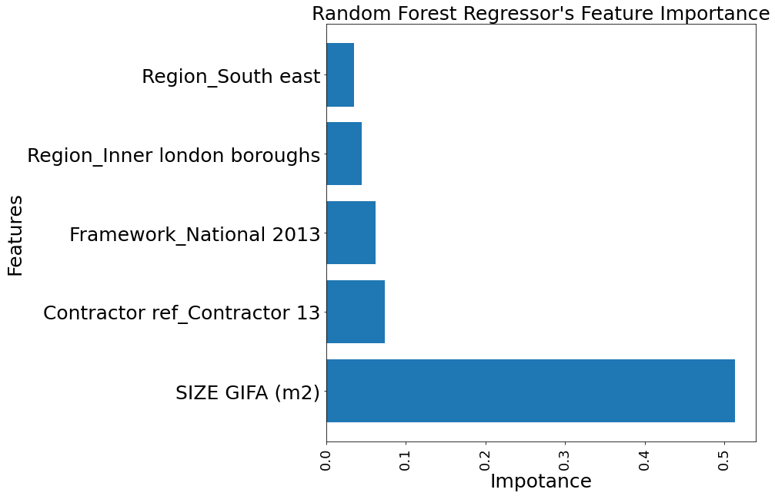
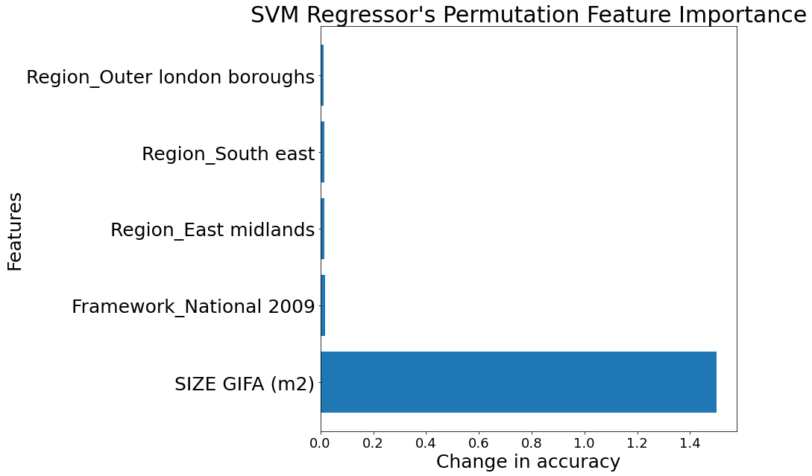
Predictive Model Building II- Predictive Characteristics
Actual External Costs
Actual Abnormal Costs
Actual Total Costs

Slide 17
Improving Predictability

Slide 18
Improving Predictability
Establish a process to investigate data quality problems
Accuracy
Completeness
Uniqueness
Behaviour changes i.e Build and foster a data quality mindset in DfE, Invest in people with the right skills, through training if necessary…
Make the Diff External and Diff Abnormal have more balanced categories (but actually would mean improving estimating performance)
Include more independent variables.

